Slide 1
BLIND SPOT MONITORING

Slide 2
UI
DEMO

Slide 3
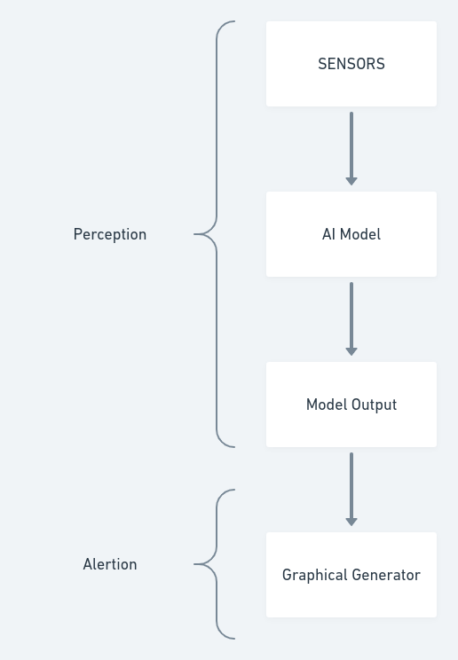
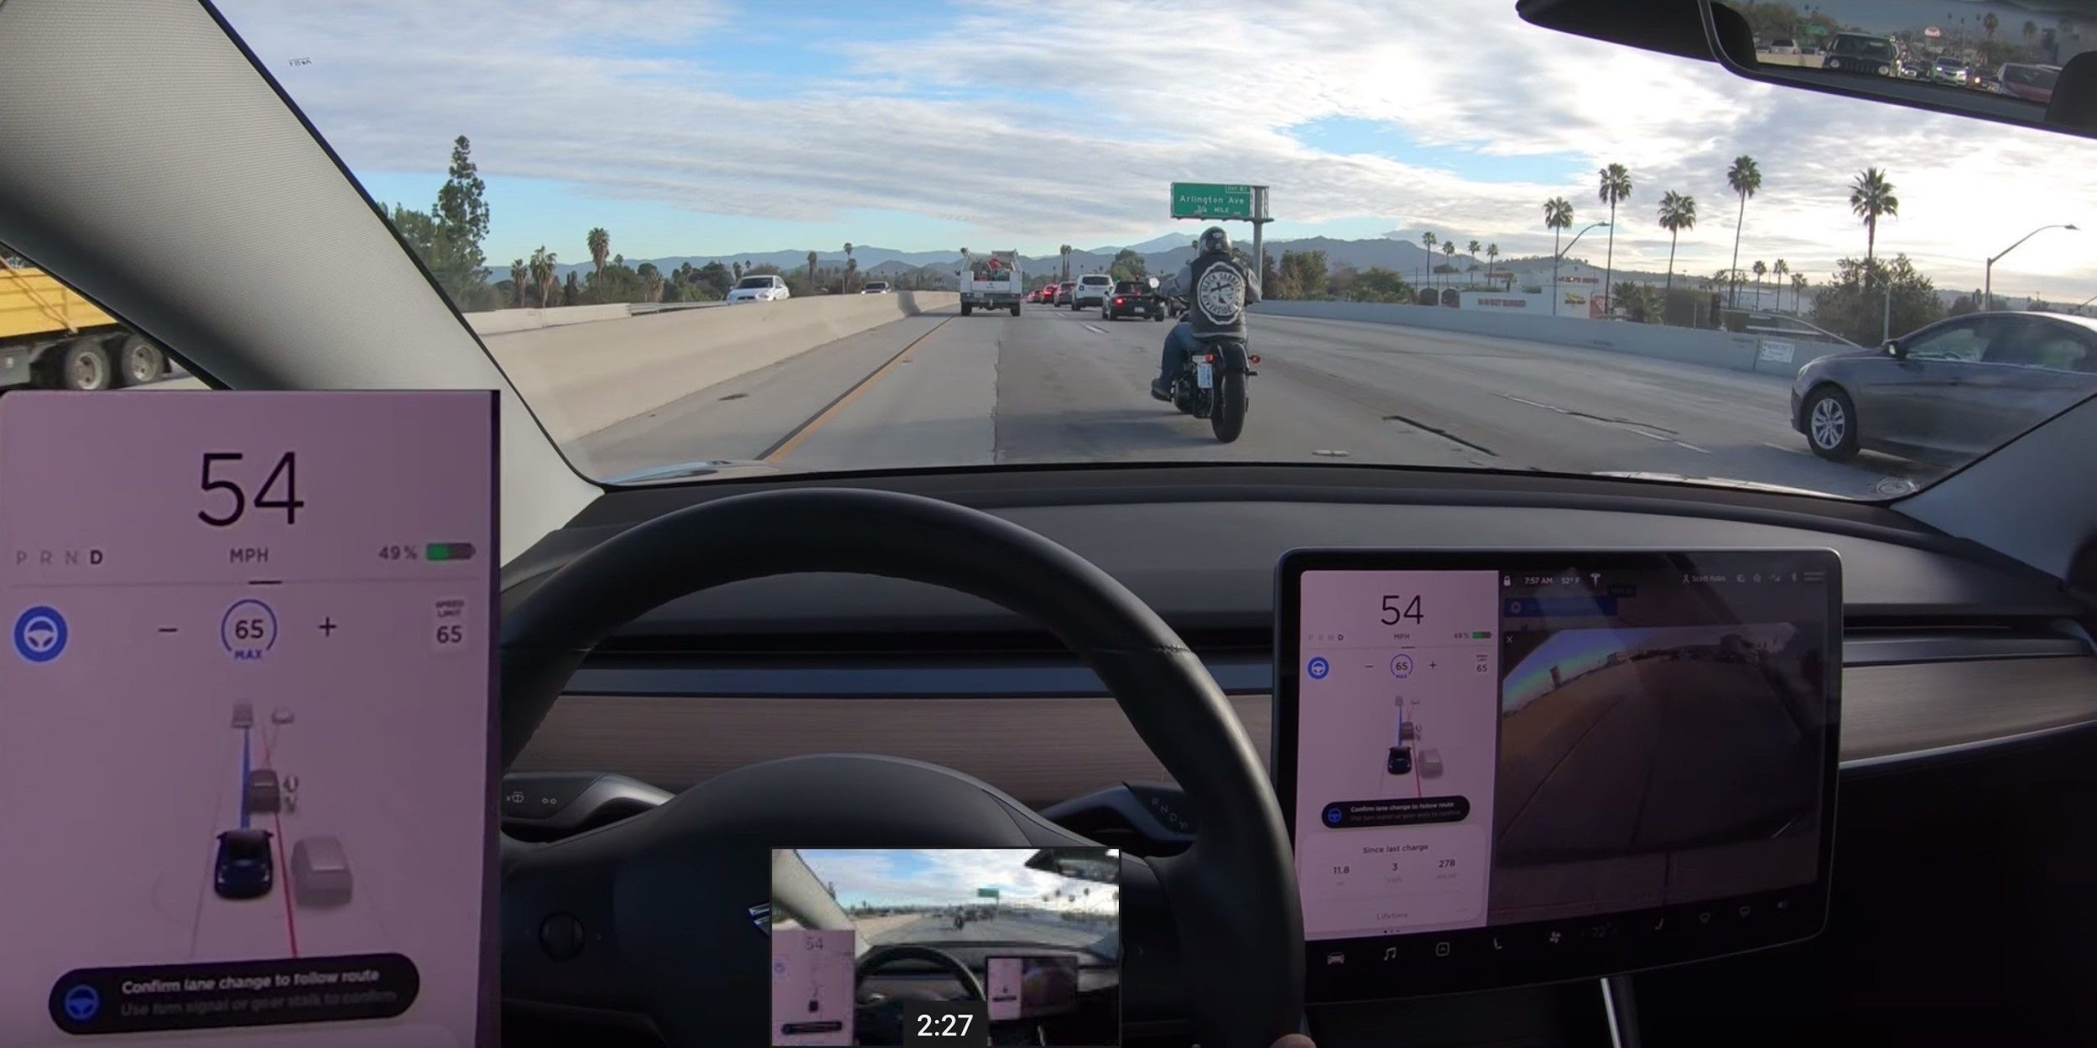
Approach towards solution

Slide 4
CURRENT STATUS:
Perception
Trying out different AI models
Improving Model evaluation module
Alertion :
UI beta stage reached
Object models to be added

Slide 5
Thank You

